Slide 1
Sampling Rotation Groups using Halton Sequence and Hopf Coordinates
Wai-Shing Luk
luk@fudan.edu.cn
(confidential)

Slide 2
Abstract
Sampling SO(3) rotation groups has a wide range of applications, such as
Robotic Motion Planning
Computational Chemistry and Biology
Computer Graphic
We propose a simple yet effective method which:
Utilizes low-discrepancy sequence, and
Hopf coordinates for SO(3)
Contains only 10 lines of MATLAB code in our implementation!
Allow incremental generation.
Numerical results shows that the proposed method outperforms the randomly generated sequences …

Slide 3
Overview
Motivation and applications
Review of Low discrepancy sequence
Van der Corput sequence on [0,1]
Halton sequence on [0,1]^{d}
Halton sequence on sphere (i.e. S²)
S³ and SO(3) using Hopf coordinate
Numerical Experiments
Conclusion

Slide 4
Introduction

Slide 5
Sampling SO(3) Occurs in:
Motion Planning (generate good paths in C-space)
Automotive Assembly
Computational Chemistry and Biology
Manipulation Planning
Medical applications
Computer Graphics (motions for digital actors)
Autonomous vehicles and spacecrafts
Notes:
Rotation

Slide 6
Problem Formulation
Desirable properties of samples over the SO(3):
Uniform and Incremental
The uniformity measures are optimized with every new point.
Reason: it is unknown how many points are needed to solve the problem in advance

Slide 7
Halton Sequence & Hopf Coordinates
On one hand, Halton sequence on S² has been well studied for S² [CuiFreeden 97, WongLuk97] by using cylindrical mapping.
Yet it is still unknown for S³ and SO(3)
On the other hand, Hopf coordinates are used for generating uniform grid points on S³ and SO(3) [Yershova et. al. 2010].
In this talk, we combine this two techniques.

Slide 8
Review of Halton sequence

Slide 9
Basic: Van der Corput sequence
Generate low discrepancy sequence over [0, 1]
Denote vd(k,b) as a Van der Corput sequence of k points, where b is the base number.
Matlab code is available at http://www.mathworks.com/matlabcentral/fileexchange/15354-generate-a-van-der-corput-sequence

Slide 10
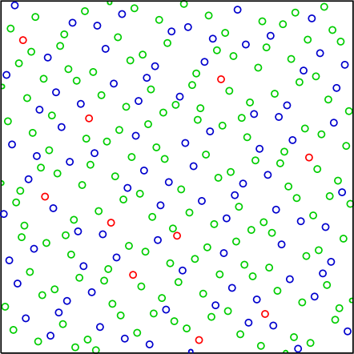
Unit Square [0,1] x [0,1]
Halton sequence: using 2 Van der Corput sequences with coprime bases. For example:
[x, y] = [vd(k,2), vd(k,3)]

Slide 11
Unit Hypercube [0, 1]^{d}
Generally we can generate Halton sequence in a unit hypercube [0, 1]^{d}
[x₁, x₂, x₃, …, x_{d}] = [vd(k,b₁), vd(k,b₂), … vd(k,b_{d})]
A wide range of applications on Quasi-Monte Carlo Methods (QMC).
Low discrepancy
Incremental generation

Slide 12
Unit Circle S¹
Can be generated by mapping the Van der Corput sequence to [0, 2π]:
θ = 2π * vd(k, b)
[x, y] = [cos(θ), sin(θ)]
Generalized discrepancy can be defined. Work very well on both straight lines and circles.

Slide 13
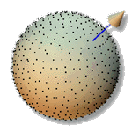
Unit Sphere S²
Cylindrical mapping is used:
[x, y, z] = [√(1-z²) cos(ϕ), √(1-z²) sin(ϕ), z]
ϕ = 2π * vd(k, b₁) % map to [0, 2π]
z = 2*vd(k, b₂) – 1 % map to [-1, 1]
Has been applied for computer graphic applications [WongLuk 97]

Slide 14
Spheres S³ and SO(3)
Random sequences:
To generate random points on S^{d}, spherical symmetry of the multidimensional Gaussian density function can be exploited.
Then the normalized vector (x_{i}/||x_{i}||) is uniformly distributed over the hypersphere S^{d}.
[Fishman, G. F. (1996)]
Deterministic point sets
Optimal discrepancy point sets for S^{d}, SO(3)
[Lubotzky, Phillips, Sarnak 86] [Mitchell 07]
No Halton sequences to our knowledge
Notes:
To generate uniformly distributed random points on a hypersphere Sd, spherical symmetry of the multidimensional Gaussian density function can be exploited (Fishman 1996). Then the normalized vector (xi/||xi||) is uniformly distributed over the hypersphere S^d.
Fishman, G. F. (1996). Monte Carlo: Concepts, Algorithms, and Applications. Berlin, Springer.
Mitchell, J. C. (2007). Sampling rotation groups by successive orthogonal images. SIAM Journal on Scientific Computing, 30(1): 525–547.

Slide 15
Hopf coordinates

Slide 16
SO(3) Coordinates
Spherical coordinates:
x₁ = cos(θ₃)
x₂ = sin(θ₃) cos(θ₂)
x₃ = sin(θ₃) sin(θ₂) cos(θ₁)
x₄ = sin(θ₃) sin(θ₂) sin(θ₁)
Hopf coordinate (cf. Yershova et. al. 2010):
x₁ = cos(θ/2) cos(ψ/2)
x₂ = cos(θ/2) sin(ψ/2)
x₃ = sin(θ/2) cos(ϕ + ψ/2)
x₄ = sin(θ/2) sin(ϕ + ψ/2)

Slide 17
How is it related the rotations?
???

Slide 18
Hopf Coordinates for SO(3) or S³
Similar to the Halton seqeuce generation on S², we perform the mapping:
ϕ = 2π * vd(k, b₁) % map to [0, 2π]
ψ = 2π * vd(k, b₂) % map to [0, 2π] for SO(3),
or ψ = 4π * vd(k, b₂) % map to [0, 4π] for S³
z = 2*vd(k, b₃) – 1 % map to [-1, 1]
θ = cos⁻¹z

Slide 19
10 Lines of MATLAB code for S³
function[s] = sphere3_hopf(k,b)
% sphere3_hopf Halton sequence
phi = 2*pi*vdcorput(k,b(1)); % map to [0, 2*pi]
psy = 4*pi*vdcorput(k,b(2)); % map to [0, 4*pi]
z = 2*vdcorput(k,b(3)) - 1; % map to [-1, 1]
theta = acos(z);
cos_eta = cos(theta/2);
sin_eta = sin(theta/2);
s = [cos_eta .* cos(psy/2), ...
cos_eta .* sin(psy/2), ...
sin_eta .* cos(phi + psy/2), ...
sin_eta .* sin(phi + psy/2)];

Slide 20
Numerical experiment

Slide 21
Testing the Correctness
Compare the discrepancy with the random point-set.
Construct the convex hull for each point-set.
Discrepancy roughly measured by the determinant of the largest facet:
max |det([1, p₁– p₀, p₂– p₀, … p_{n}– p₀,])|
Better idea???
Notes:
To generate uniformly distributed random points on a hypersphere Sd, spherical symmetry of the multidimensional Gaussian density function can be exploited (Fishman 1996). Then the normalized vector (xi/||xi||) is uniformly distributed over the hypersphere S^d.
Fishman, G. F. (1996). Monte Carlo: Concepts, Algorithms,
and Applications. Berlin, Springer.

Slide 22
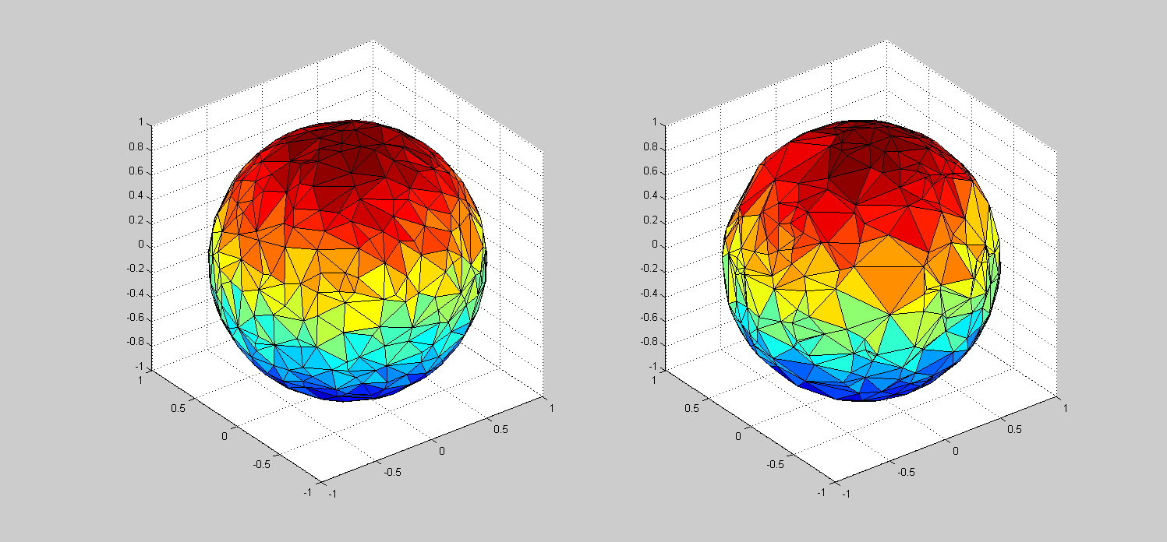
Convex Hull with ~400 points on S²
Low discrepancy point-set
Randomly generated point-set

Slide 23
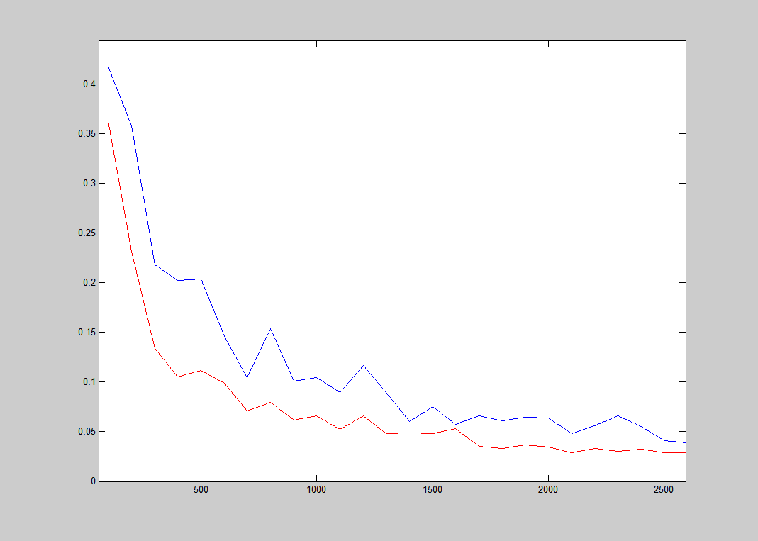
Dispersion. (S², red – our, blue – Rand)

Slide 24
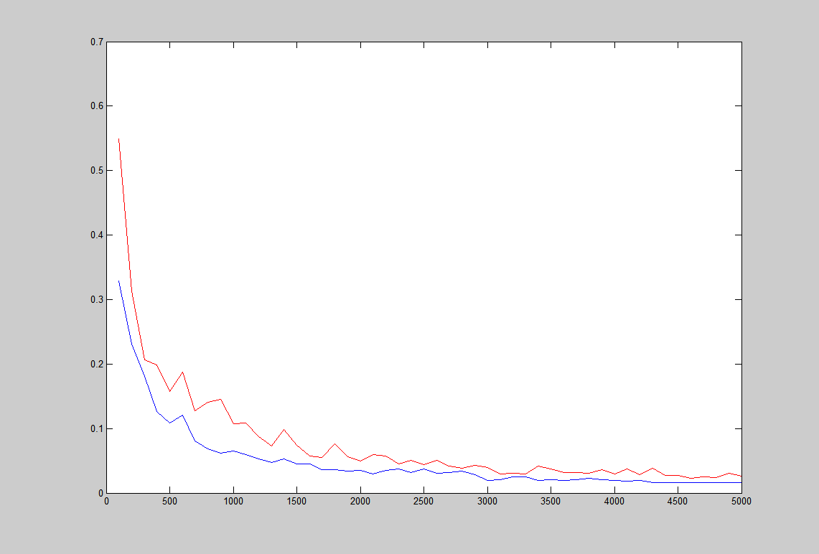
Disperson. (S³, blue – our, red – Rand)

Slide 25
Conclusions
Proposed a simple yet effective method that generates low-discrepancy point set in nearly linear time.
The result outperforms the corresponding randomly generated point set, especially when the number of points is small.

Slide 26
Any Suggestions?

